Slide 1

Tracking Technology: An Analysis into a Stack Overflow Developer Survey
RANI MISRA
24 AUGUST 2024

Slide 2

OUTLINE
Executive Summary
Introduction
Methodology
Results
Visualization – Charts
Dashboard
Discussion
Findings & Implications
Conclusion
Appendix

Slide 3

EXECUTIVE SUMMARY
Most in-demand programming languages:
JavaScript, HTML/CSS, SQL, Bash/Shell/PowerShell, Python
Most in-demand databases:
MySQL, Microsoft SQL Server, PostgreSQl, SQLite, MongoDB
Popular Platforms:
Windows, Linux, Docker, AWS, MacOS
Popular Web Frames:
jQuery, Angular/Angular.js, React.js, ASP.NET, Express
Future Technology Trends:
Python gains popularity, reaching the top three programming languages used.
MongoDB, Redis, and Elasticsearch have increase usage when it comes to database management systems.

Slide 4

INTRODUCTION
Various key trends have presented itself over the last decade in the programming and technology landscape.
These trends provide insights into the evolving environment of programming languages, frameworks, and demographics of developers.
Stack Overflow conducts a thorough survey amongst professional developers worldwide.
Almost 90,000 developers participated in this survey in 2019.

Slide 5

METHODOLOGY
Data is gathered from a survey conducted by Stack Overflow from January 23 to February 14 in 2019 and involved 88,883 software developers from 179 countries.
This research was conducted through completing labs provided by IBM via Coursera, with a wide variety of tools utilized such as Data Exploration, Data Wrangling, Exploratory Data Analysis, and Data Visualization.
Included data analysis and visualization was performed on IBM Cognos Analytics.

Slide 6
RESULTS
Preference for Python increases causing it to become the 5th most preferred language, ahead of Java.
JavaScript remains as the most used programming language.
jQuery is the most popular web frame in 2019. However, the top spot is taken over by React.js in the following year.
MySQL is the most used database. In the following year, PostgreSQL climbs 2 spots to become the top contender and pushes MySQL down to the 3rd most used database.
Men make up almost 94% of the respondents in the survey overall. Female representation is maximized in the Bachelor’s degree category under Formal Education, but men still dominate the category.

Slide 7
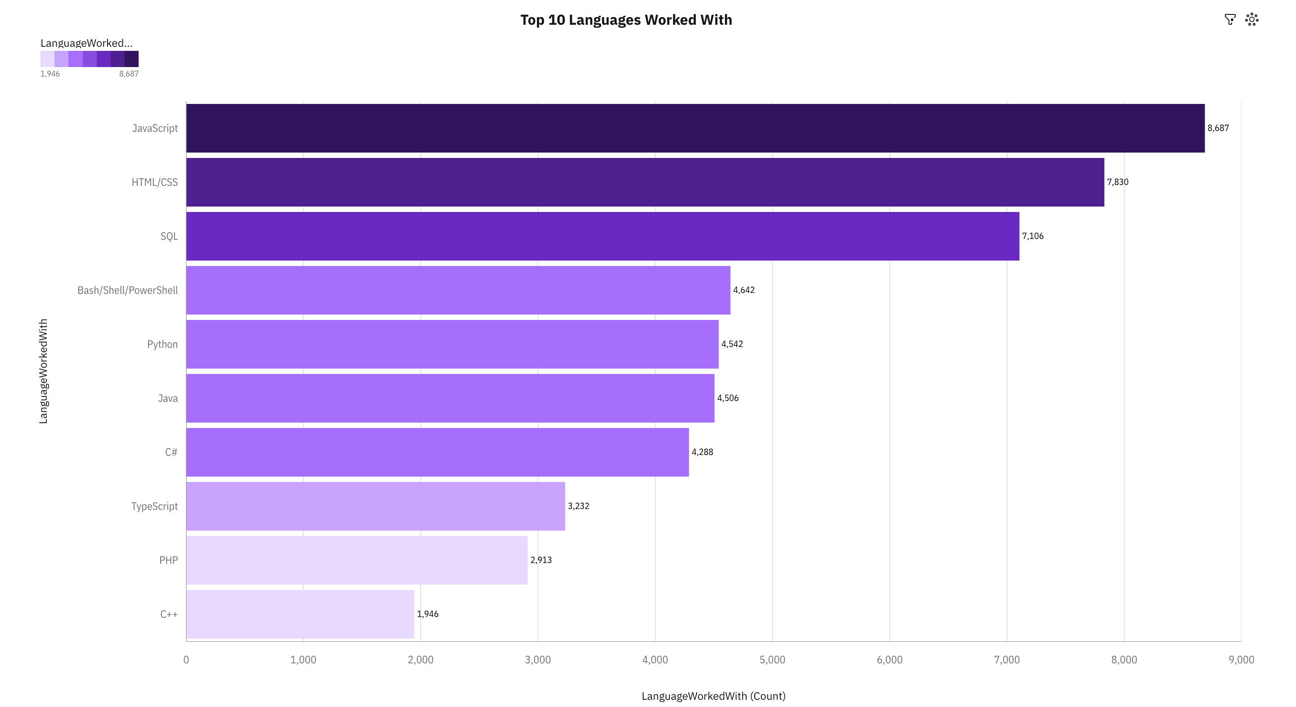
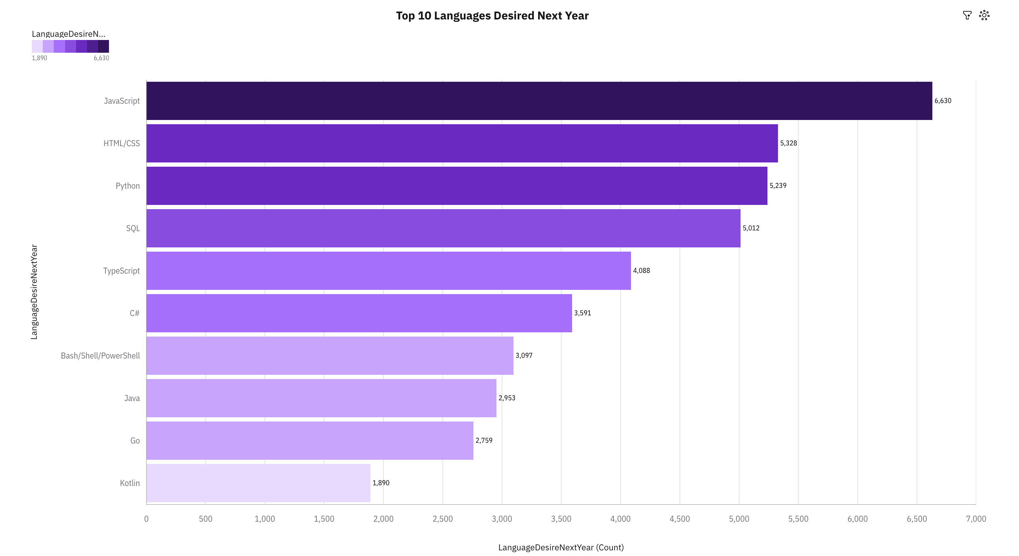
PROGRAMMING LANGUAGE TRENDS
Current Year
Next Year

Slide 8
PROGRAMMING LANGUAGE TRENDS - FINDINGS & IMPLICATIONS
Findings
JavaScript and HTML/CSS are the most used programming languages among all respondents.
SQL is a stronger contender for being a preferred programming language.
Python and Java are close competitors, with Python being slightly more popular.
Implications
JavaScript and HTML/CSS are foundational languages that are key for modern web development.
Increasing popularity in SQL highlights the role of data management and querying in modern software and data analysis applications.
The rising popularity of Python could imply ease of use and flexibility, which attracts new developers.

Slide 9
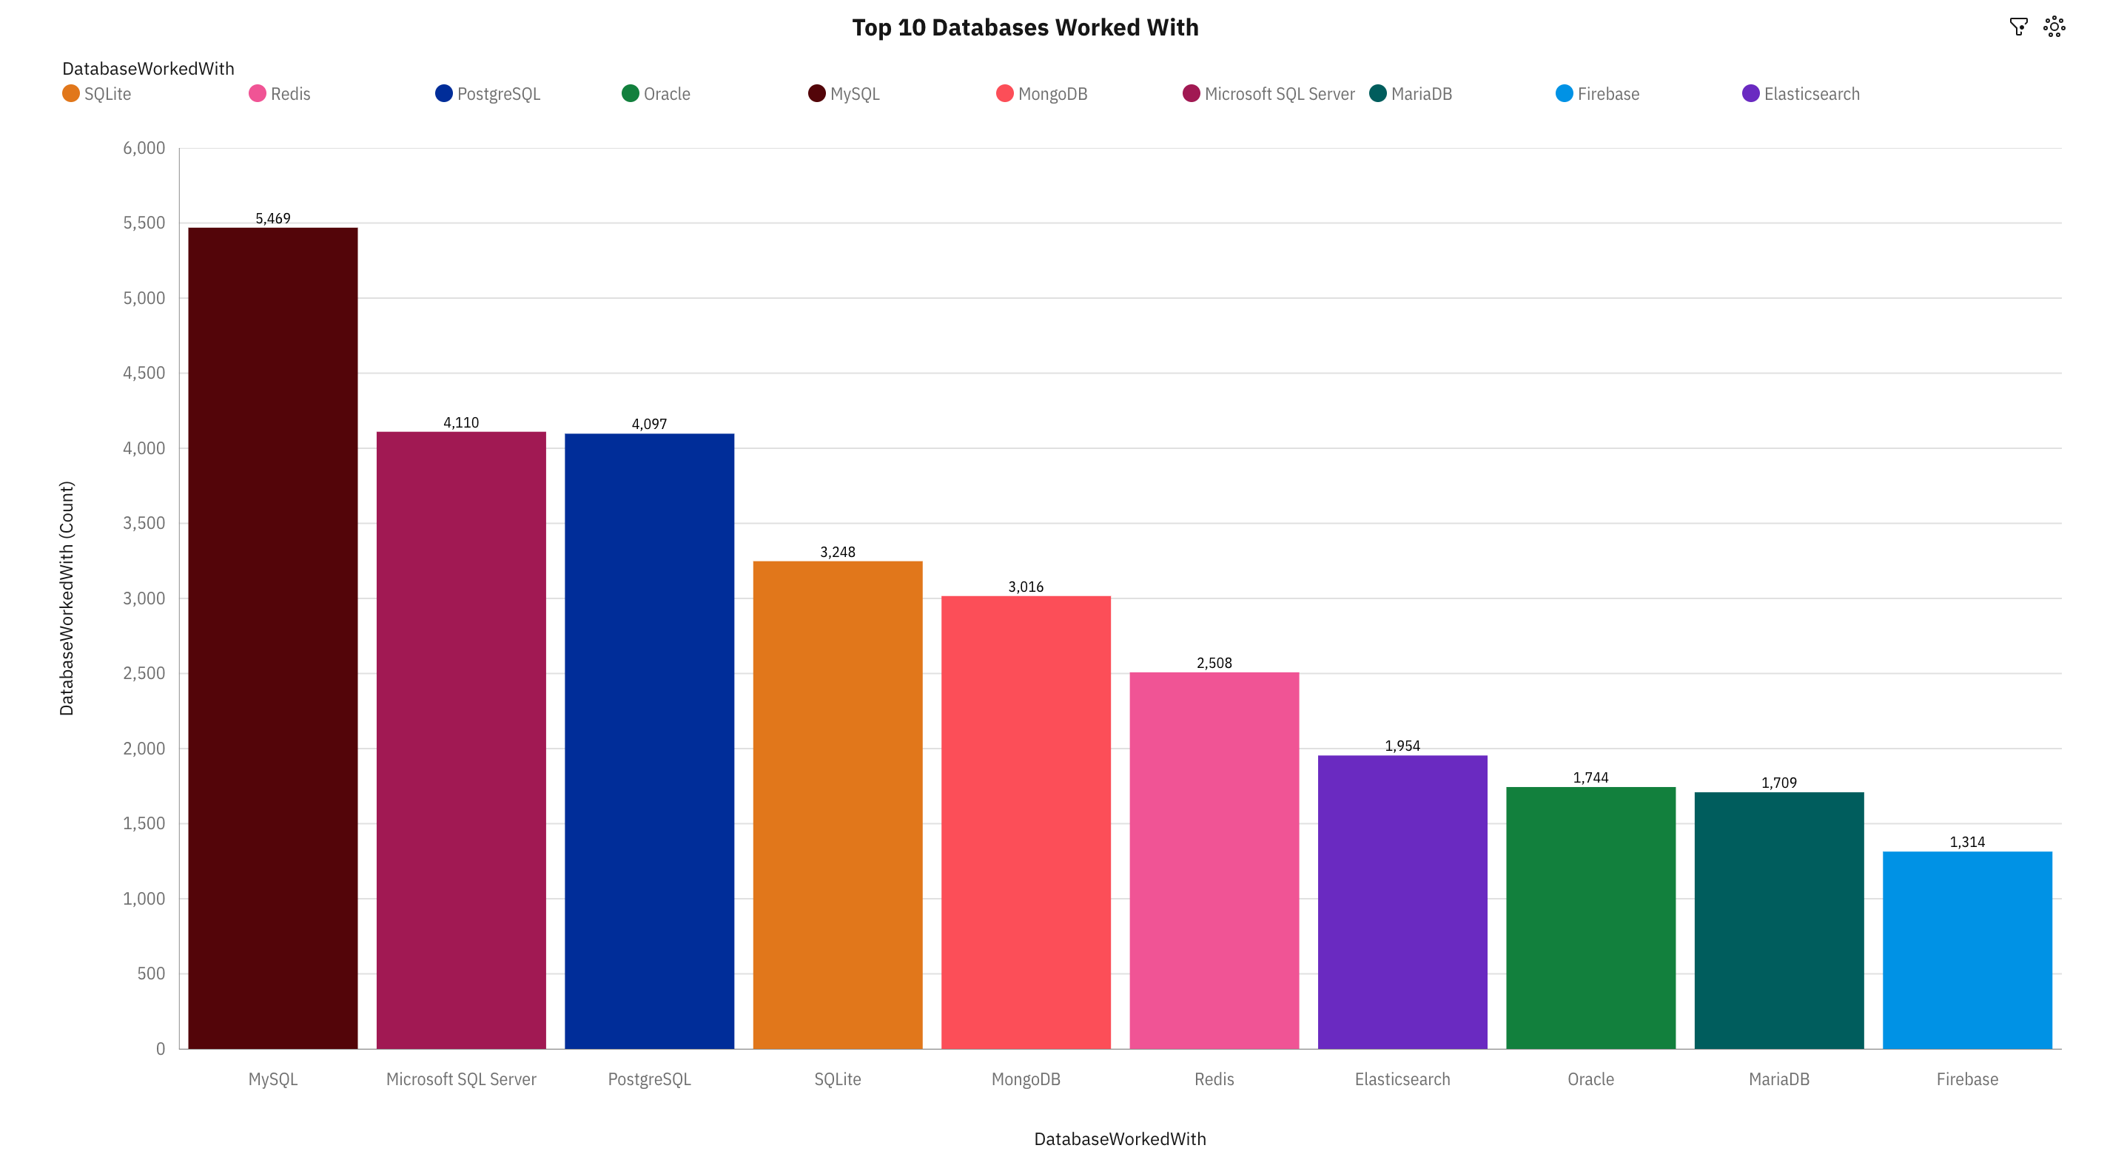
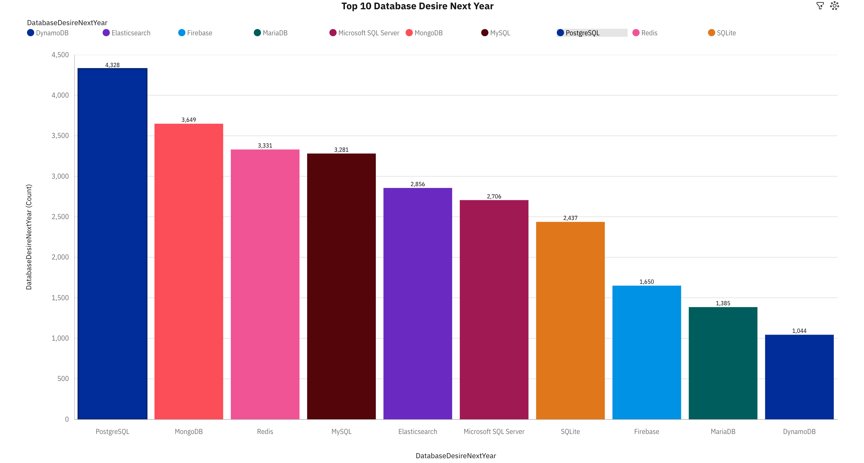
DATABASE TRENDS
Current Year
Next Year

Slide 10
DATABASE TRENDS - FINDINGS & IMPLICATIONS
Findings
MySQL is the leading database management system.
Microsoft SQL Server and PostgreSQL closely follow behind.
MongoDB is the top NoSQL database.
Implications
Popularity of MySQL, Microsoft SQL Server, and PostgreSQL highlights the need for relational databases across various software development applications.
The high presence of MongoDB illustrates a trend towards NoSQL methods caused by the need of flexible data models.
The variety of databases present in the Top 10 depict how specific tools are required for different applications depending on the requirements and analyses to be performed.

Slide 11

DASHBOARD
These dashboards can be accessed using the link below;
https://github.com/rani-misra/coursera/blob/main/IBM%20Data%20Analyst%20Capstone%20Project/IBM%20Data%20Analyst%20Capstone%20Project%20Dasboards%20Updated.pdf

Slide 12
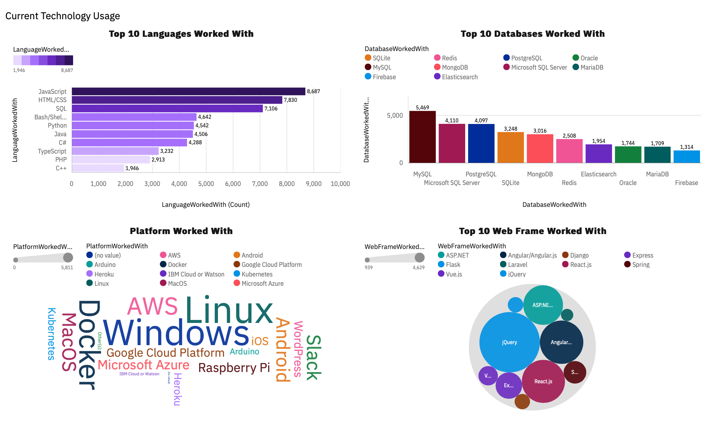
CURRENT TECHNOLOGY USAGE

Slide 13
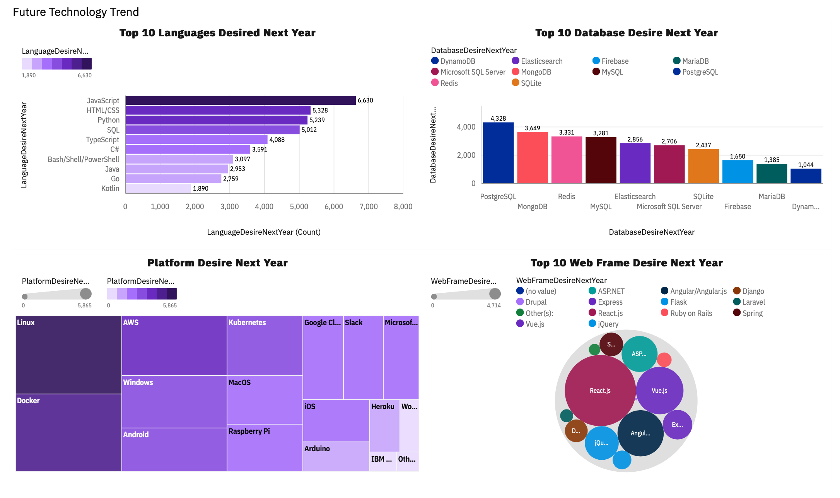
FUTURE TECHNOLOGY TREND

Slide 14
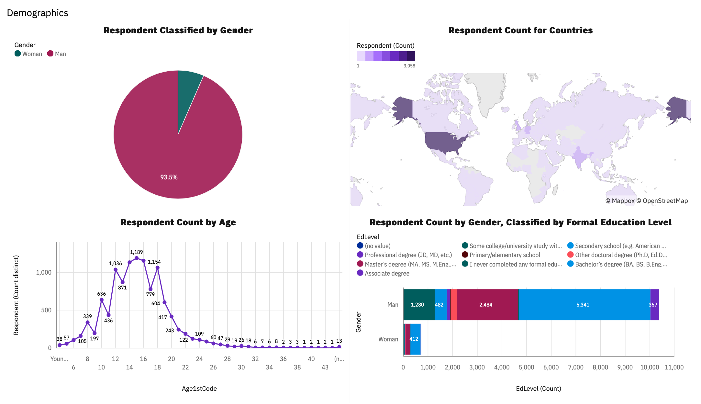
DEMOGRAPHICS

Slide 15
DISCUSSION
The continued popularity of JavaScript and HTML/CSS are leading programming languages.
The industry reliance on MySQL as a database management system.
Evolving nature of web technologies that could lead to the introduction of new programming languages and databases.

Slide 16
OVERALL FINDINGS & IMPLICATIONS
Findings
Trends in Technology: JavaScript and HTML/CSS dominating other programming languages illustrates the importance of its foundations in web development.
Data Management: Use of SQL DBMSs such as MySQL, Microsoft SQL Server, and PostgreSQL highlights the critical role of effective data management in web development.
Diverse Tools: The diversity in preferred languages and databases illustrates a variety of skills and tools provided by each for varied requirements in performance.
Implications
Continued Use: The consistent use of leading programming languages depicts the continued importance of web development in the programming space due to a growing reliance on online platforms and digital media.
Database Characteristics: Organizations must take into account data structure and performance when selecting database to best suit their needs.
Standardization With Variety: While leading programming languages are presented as the industry standard, certain varying languages are also used in accordance to the organization’s needs.

Slide 17

CONCLUSION
The results illustrate that the programming industry is innovative and always changing. Programmers must adapt to new tools introduced in the development landscape.
Developers must
be willing to learn a diverse group of languages,
meet the demands of evolving applications through database management systems,
and use the right tools for optimal performance in development.

Slide 18

APPENDIX
Highest Job Postings by Location
Highest Average Annual Salary by Language

Slide 19
JOB POSTINGS

Slide 20
POPULAR LANGUAGES

